Slide 1


MODEL EVALUATION
Measuring What Matters
Assessing Model Performance
📊 Metrics | ✓ Validation
Cross-Validation, Confusion Matrix, Precision/Recall, ROC-AUC
LEARN
APPLY
MASTER

Slide 2
Overview of core concepts
Cross-Validation
k-fold, stratified CV, avoid overfitting
Precision & Recall
TP/FP/FN/TN, trade-offs, business impact
ROC-AUC & PR Curves
Threshold optimization, imbalanced data
Choosing Metrics
Decision framework, real-world examples

Slide 3
1. Cross-Validation - Why
Single Split Problem
Data: 80% train, 20% test
Issues:
- Test set might be easy
→ Model seems good
- Test set might be hard
→ Model seems bad
- Only 1 measurement
→ Unreliable
CV Solution
Split into k=5 folds
Create 5 models:
Each tests on 1 fold
Each trains on 4 folds
Average 5 results
Benefits:
- Reliable average
- Detect overfitting
- Better estimate

Slide 4
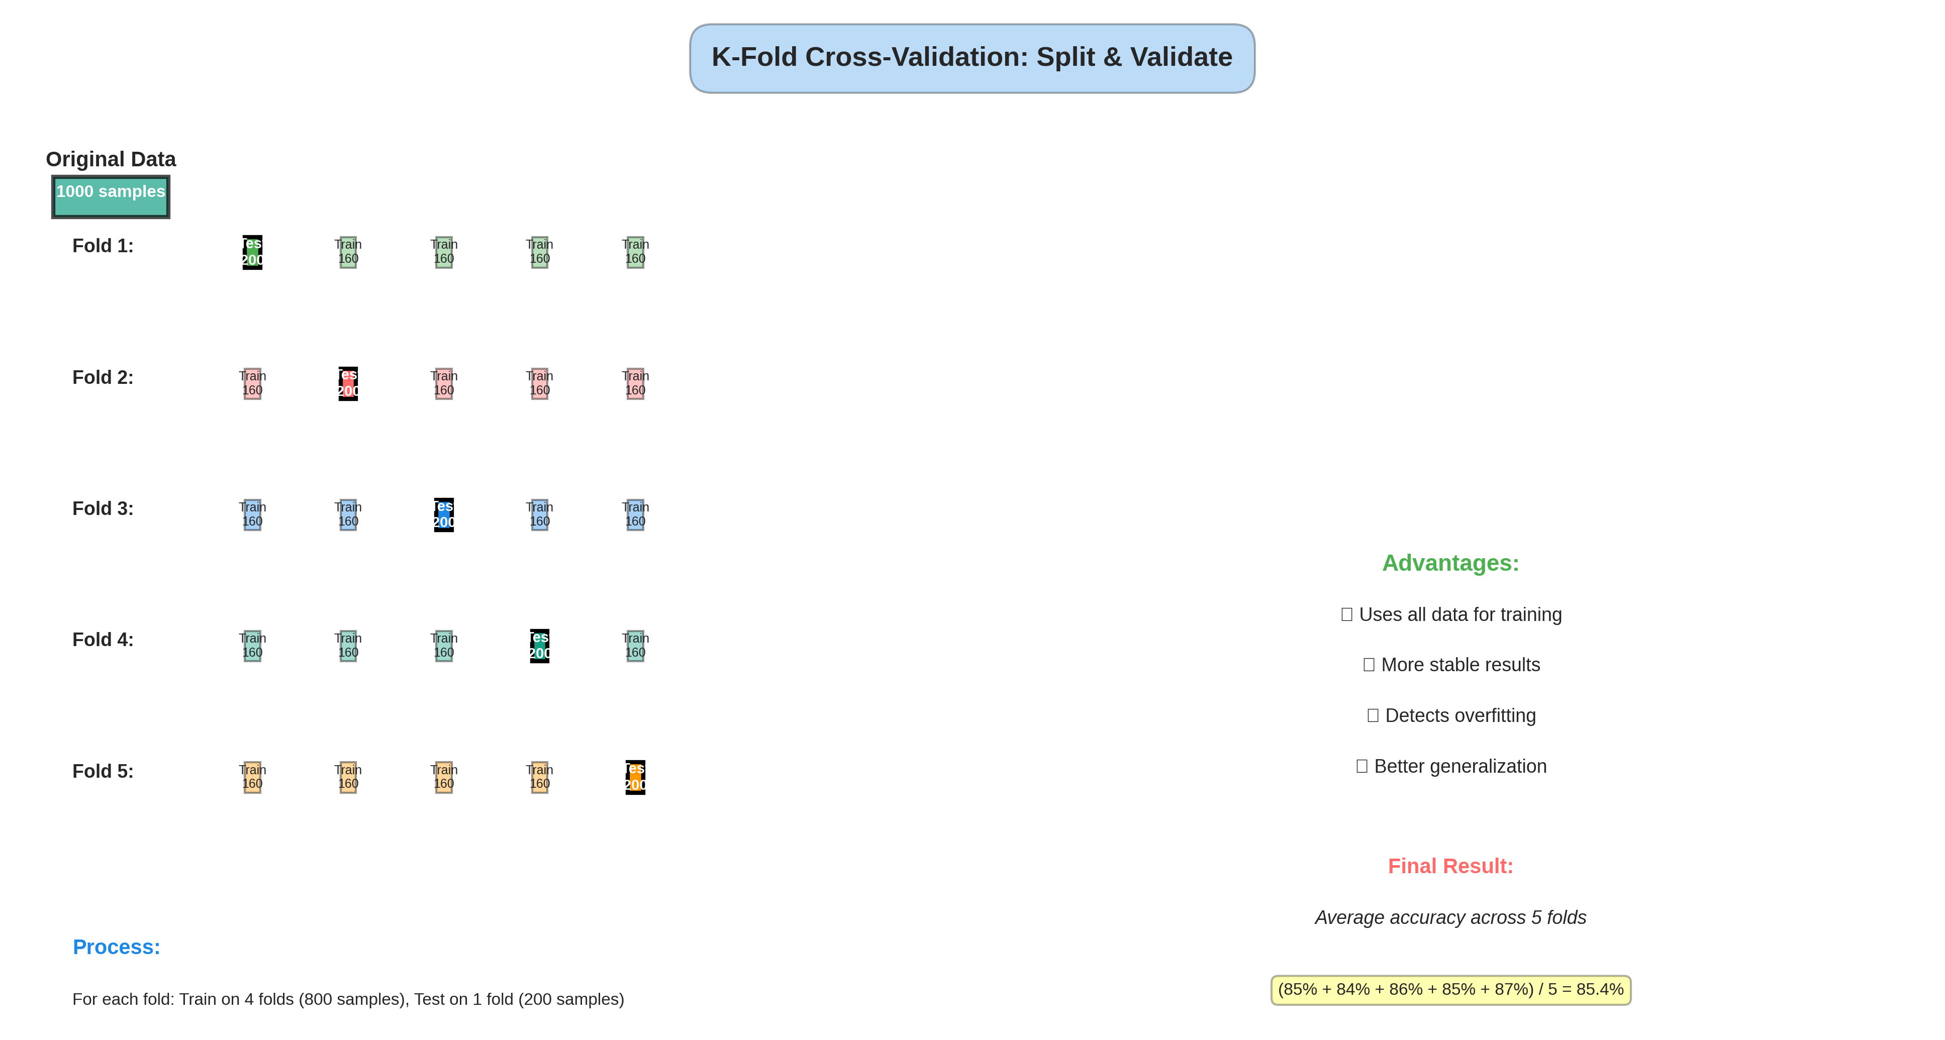
2. Cross-Validation Process

Slide 5
3. CV in Practice
CROSS-VALIDATION EXAMPLE:
Dataset: 1000 patient records
5-FOLD CV PROCESS:
Fold 1: Train 800 → Test 200 → Accuracy 85%
Fold 2: Train 800 → Test 200 → Accuracy 84%
Fold 3: Train 800 → Test 200 → Accuracy 86%
Fold 4: Train 800 → Test 200 → Accuracy 85%
Fold 5: Train 800 → Test 200 → Accuracy 87%
RESULT:
CV Score = Mean of folds = 85.4%
Std Dev = 1.02% (low = consistent)
INTERPRETATION:
Expected performance on new data: 85-86%
Model is reliable and stable!
WHY BETTER THAN SINGLE SPLIT:
Single split: 85% (unreliable, one time)
5-fold CV: 85.4% +/- 1.0% (reliable, 5 times)
The standard deviation matters!
- Low std: Consistent, reliable model
- High std: Unstable, unreliable model

Slide 6
4. Confusion Matrix - Types
Good Predictions
TP (True Positive):
Predicted YES,
Actually YES ✓
TN (True Negative):
Predicted NO,
Actually NO ✓
Bad Predictions
FP (False Positive):
Predicted YES,
Actually NO
False alarm!
FN (False Negative):
Predicted NO,
Actually YES
Missed case!

Slide 7
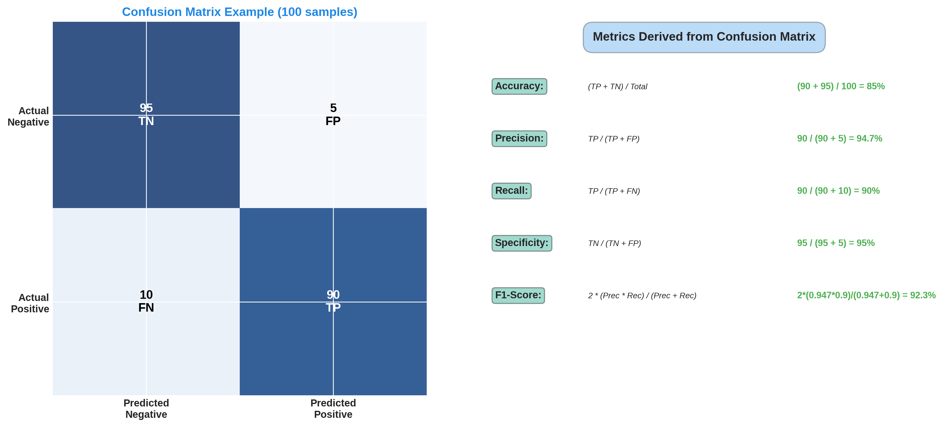
5. Confusion Matrix & Metrics

Slide 8
6. Precision - Prediction Quality
Formula
Precision = TP/(TP+FP)
Question:
Of predictions I made,
how many were correct?
Example
Cancer screening:
Predicted YES: 100
Actually YES: 90
Precision = 90/100
= 90%

Slide 9
7. Recall - Coverage
Formula
Recall = TP/(TP+FN)
Question:
Of actual positives,
how many did I catch?
Example
Cancer screening:
Actually YES: 150
Caught: 90
Recall = 90/150
= 60%

Slide 10
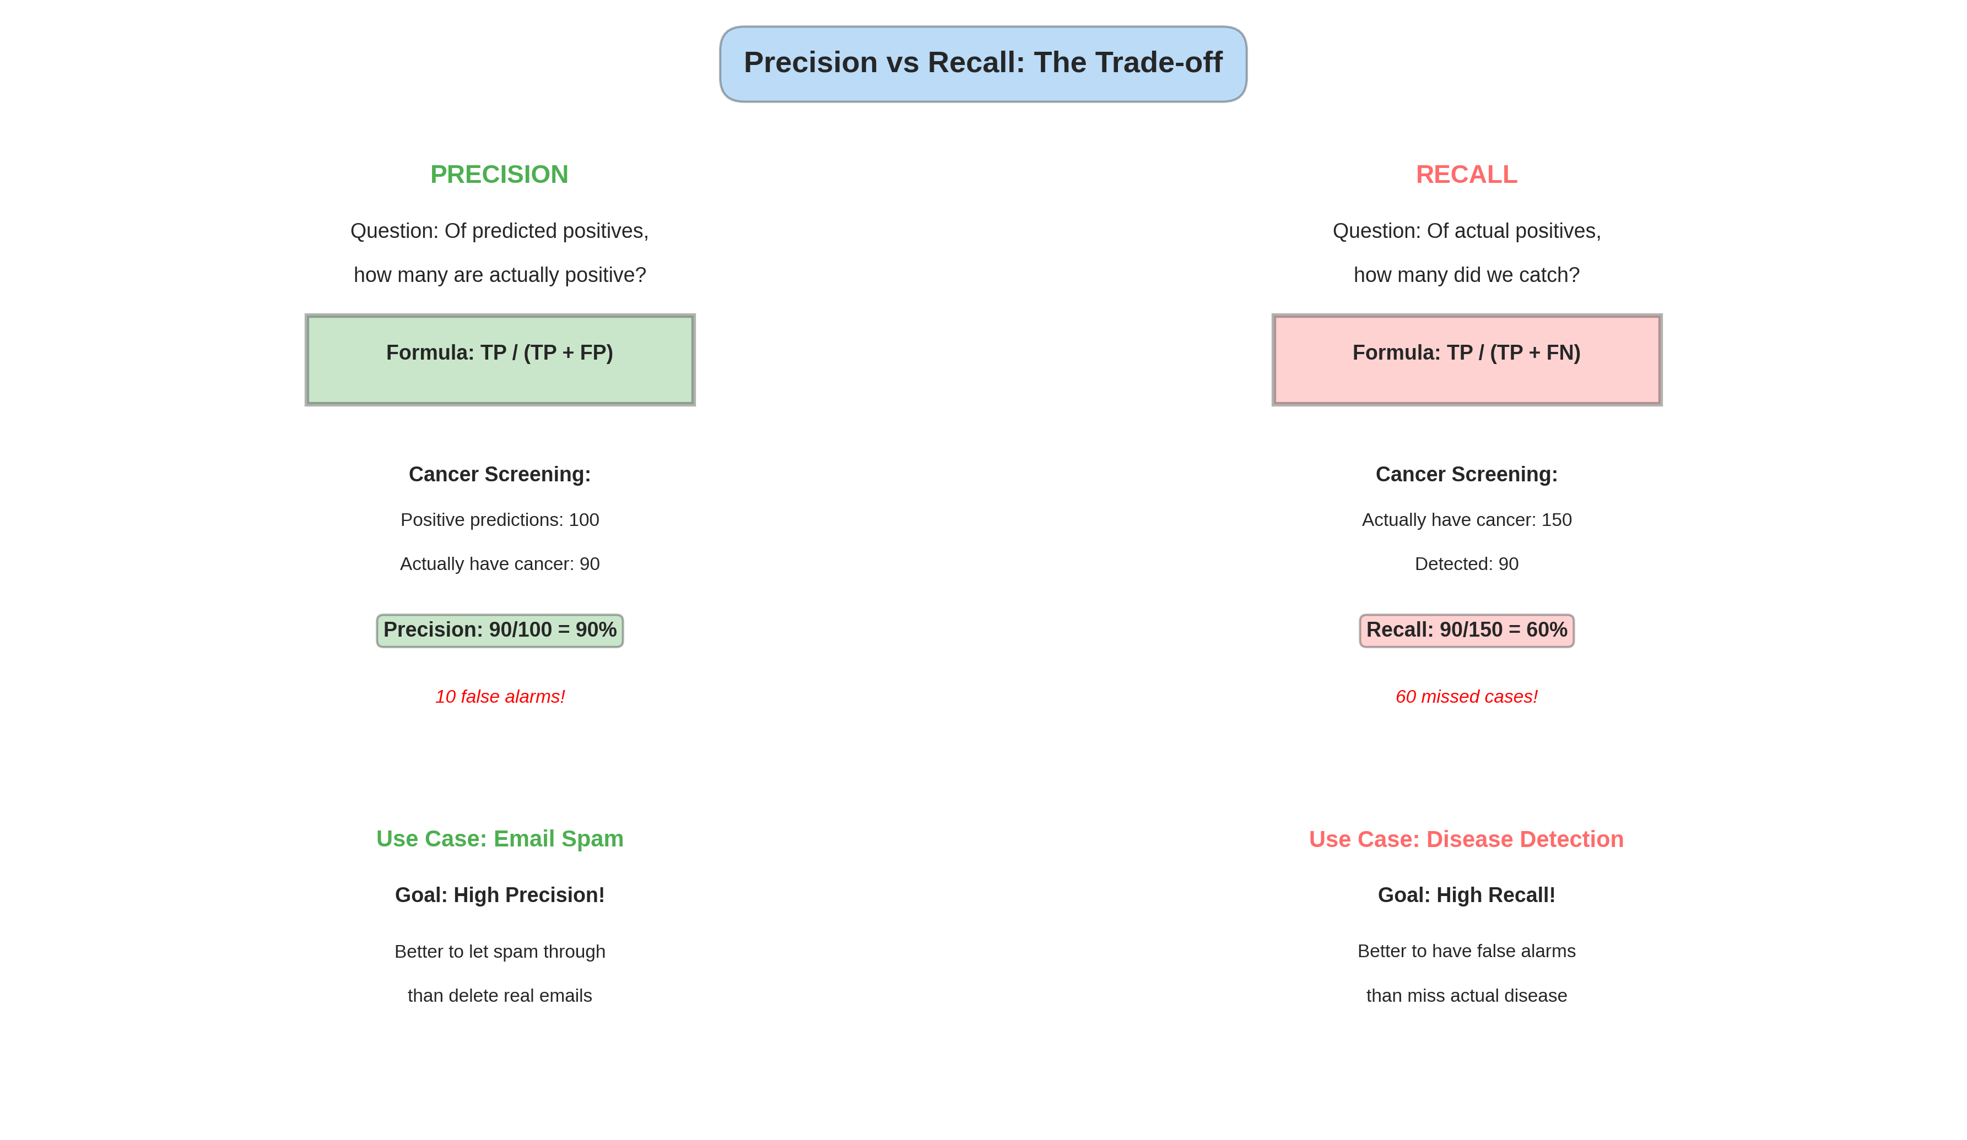
8. Precision vs Recall Trade-off

Slide 11
9. When to Optimize Each
Real-World Metric Selection
Email Spam Filter
Goal: HIGH PRECISION
Why: Deleting real email = bad
Disease Detection
Goal: HIGH RECALL
Why: Missing disease = dangerous
Fraud Detection
Goal: BALANCED F1
Why: Both FP and FN costly
Resume Screening
Goal: HIGH PRECISION
Why: Interview wrong = wasteful

Slide 12
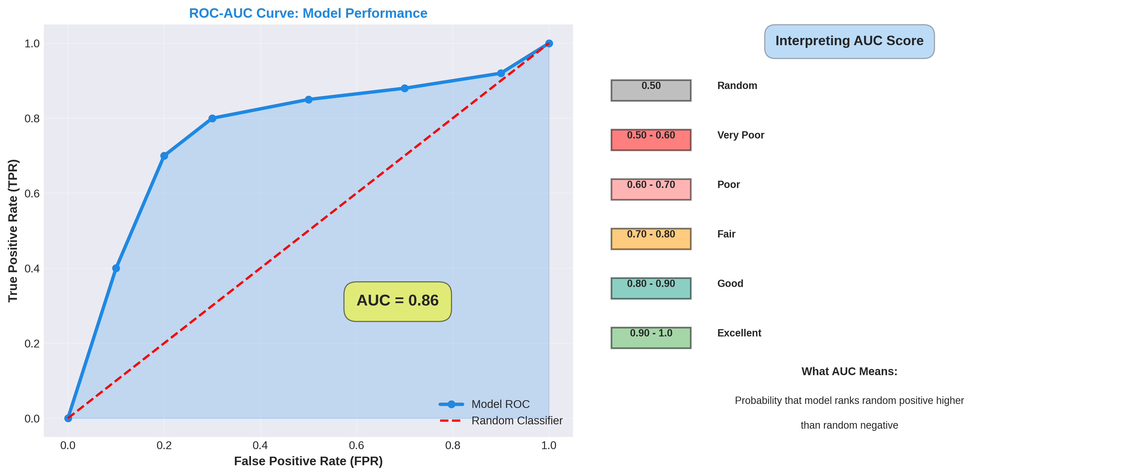
10. ROC-AUC Curve

Slide 13
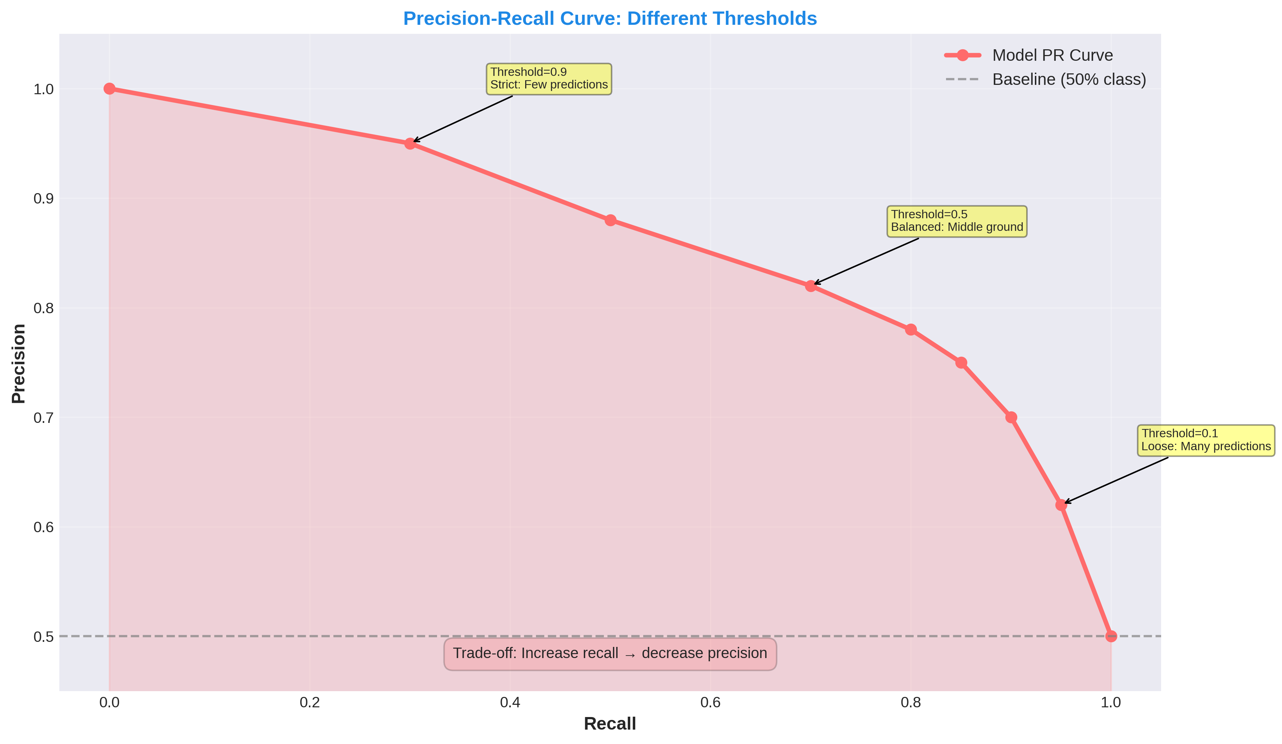
11. Precision-Recall Curve

Slide 14
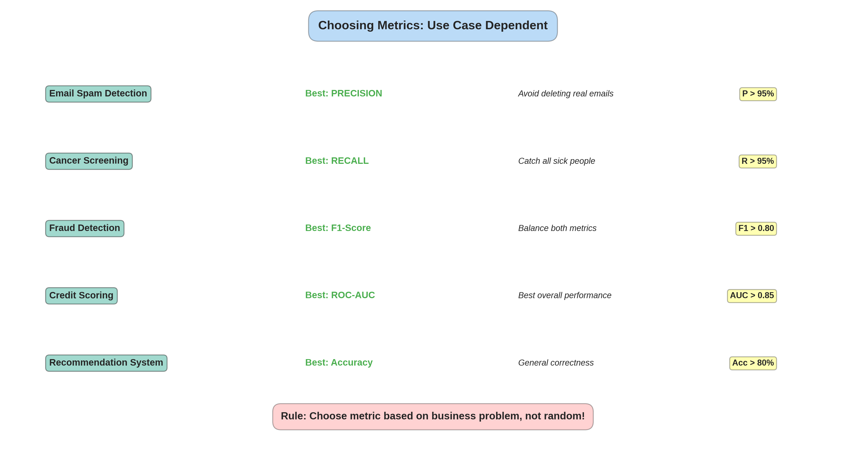
12. Metrics Selection Guide

Slide 15
Key Takeaways
ALWAYS use Cross-Validation
k=5 folds standard
Accuracy is MISLEADING
Report Precision/Recall instead
Precision vs Recall = BUSINESS choice
Not technical, depends on costs
Choose metric based on PROBLEM
Fraud: F1 | Cancer: Recall | Spam: Precision
Report std deviation too
85.4% ± 1.0% (good) vs 85% (vague)
Imbalanced data = PR Curve
Not ROC-AUC

